Slide 1
FUN WITH DOTNET TEMPLATES
With Kelly Adams

Slide 2
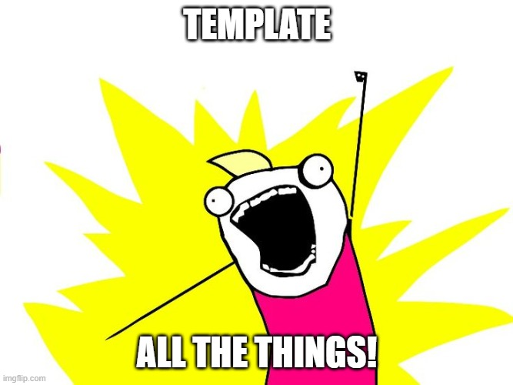
Finally! A place for all my opinions!
Good for:
Frameworks (like Coalesce)
Enforcing “standards” (or your will)
Making lawyers happy
https://github.com/IntelliTect-Samples/dotnet-templates-demo

Slide 4
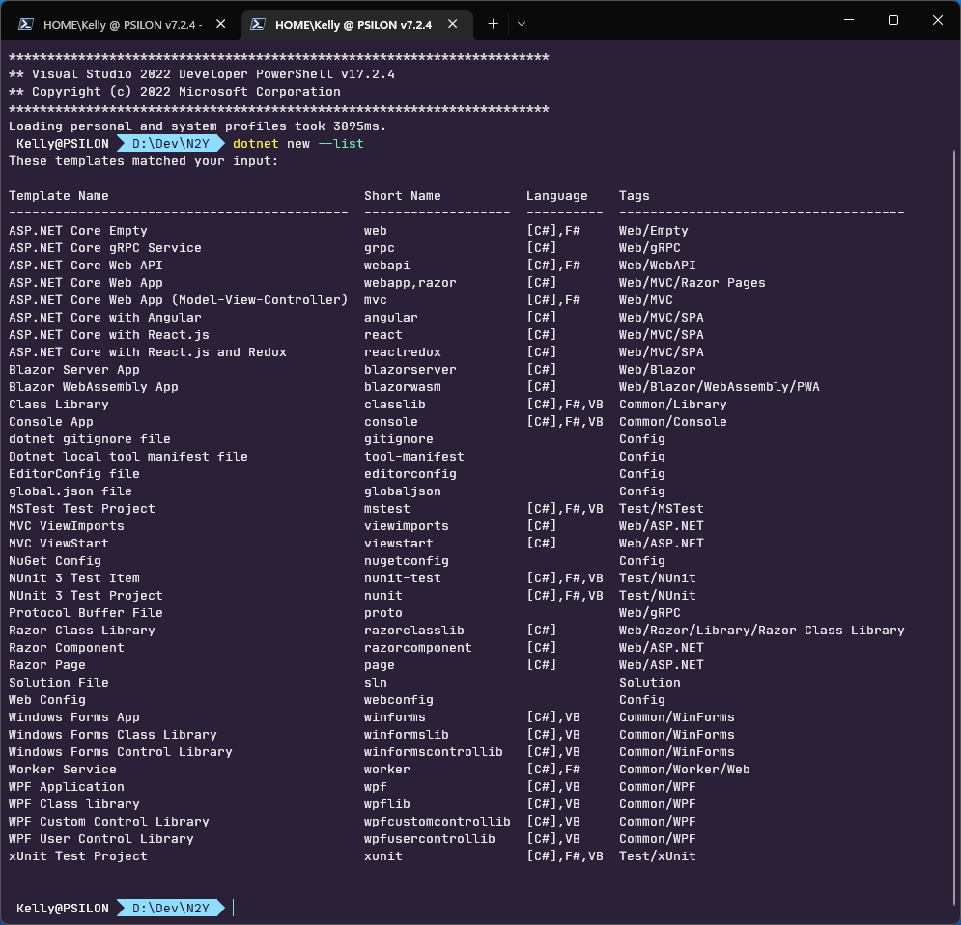
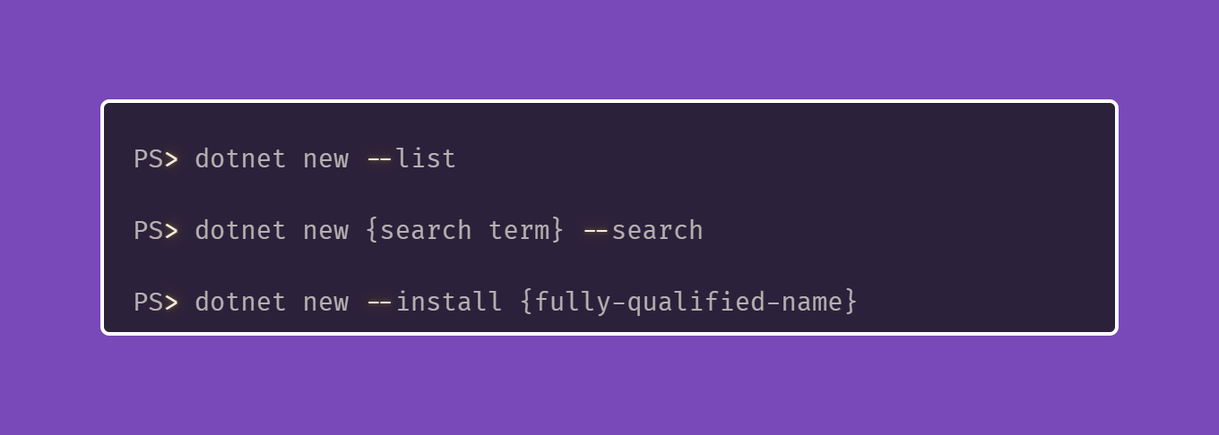
Where my templates at?
Notes:
Dotnet new –list {lists all locally installed templates}
Dotnet new some_thing_here –search searches all known repos for it
Dotnet new –install “the-fully-qualified-name-or-id-thing”

Slide 5
Project Templates
Some examples here: https://github.com/dotnet/templating/
The “manual”: https://docs.microsoft.com/en-us/dotnet/core/tools/custom-templates
A great non-MSFT example: https://github.com/sayedihashimi/template-sample

Slide 6

Feeble Example Project Template Code Demo
Notes:
The .template.config folder and contents is magically ignored
Install your template with dotnet new --install .\
Uninstall with dotnet new –uninstall .\
Magic sauce to change namespace is "sourceName": "ProjectTemplate"

Slide 7
Item Templates
A useful way to distribute code without dependencies
Isn’t limited to C# (or any lang) code though…
…pipeline YAML files? 👩‍🏭
…your Draconian .editorconfig? 😈
…mandatory lawyerly junk (©️ headers)

Slide 8

A Weaksauce Item Template Demo
Notes:
Make a new console project, install the template, dotnet new stupidext, add the idiocy below…
var _ = ""; _.WhenTrue(true).Write("This is ill-advised...");

Slide 9


Slide 10
Distribute awesome templates
With nuget of course…
Simply add a nuget publish project!
Findable with dotnet new –search

Slide 11

A Look At Nuget Packaging
Notes:
PackageType of “Template” is important so it shows up in dotnet new –search

Slide 12

THANKS!
Be awesome to everyone
Do good work
Always have three bullet points

